Slide 2
Vision Zero
Status in future progress

Slide 3
Fatalities in road-traffic accidents 2015-2023 and targets
133
Informationsklass
Nivå 2 – Intern

Slide 4
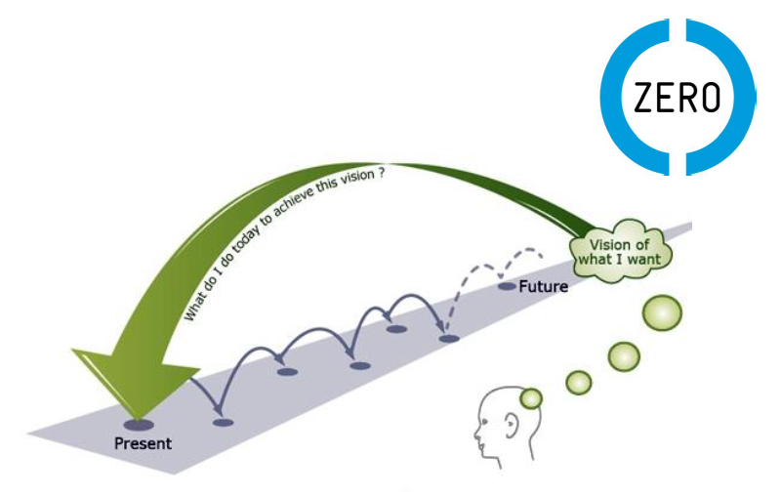

Backcasting
0
2050
2040
Scenarios to 2030 with all known plans. Conclusion: We will end up with 190 fatalities more or less 2030.
2030
?
2025
2020
Solution: more money or new and/or cheaper/more effective countermeasures
Informationsklass
Nivå 2 – Intern

Slide 5
Indicators to push
Countermeasures adressing
Safety for cyclists
Enhanced safety for heavy vehicles
Separation/calming
Leadership in companies & org
Severe injuries - vulnerable roadusers
25% of fatalities with heavy vehicles
Safe infrastructure develop too slow
Almost 50% of fatalities in someones value-chain
Informationsklass
Nivå 2 – Intern

Slide 6

Challenge – increased and safe biking to 2030
2030
Countermeasures?
Maintenance
Separation
Calming
Infrastructure
Personal safety
2020
+75%
2000 severe injured cyclists 2020
- 25%
Informationsklass
Nivå 2 – Intern
Notes:
+1 400 allvarligt skadade 2030 vid fördubblad cykling, allt annat lika *
- 500 allvarligt skadade 2030 enligt mål för 2030

Slide 7
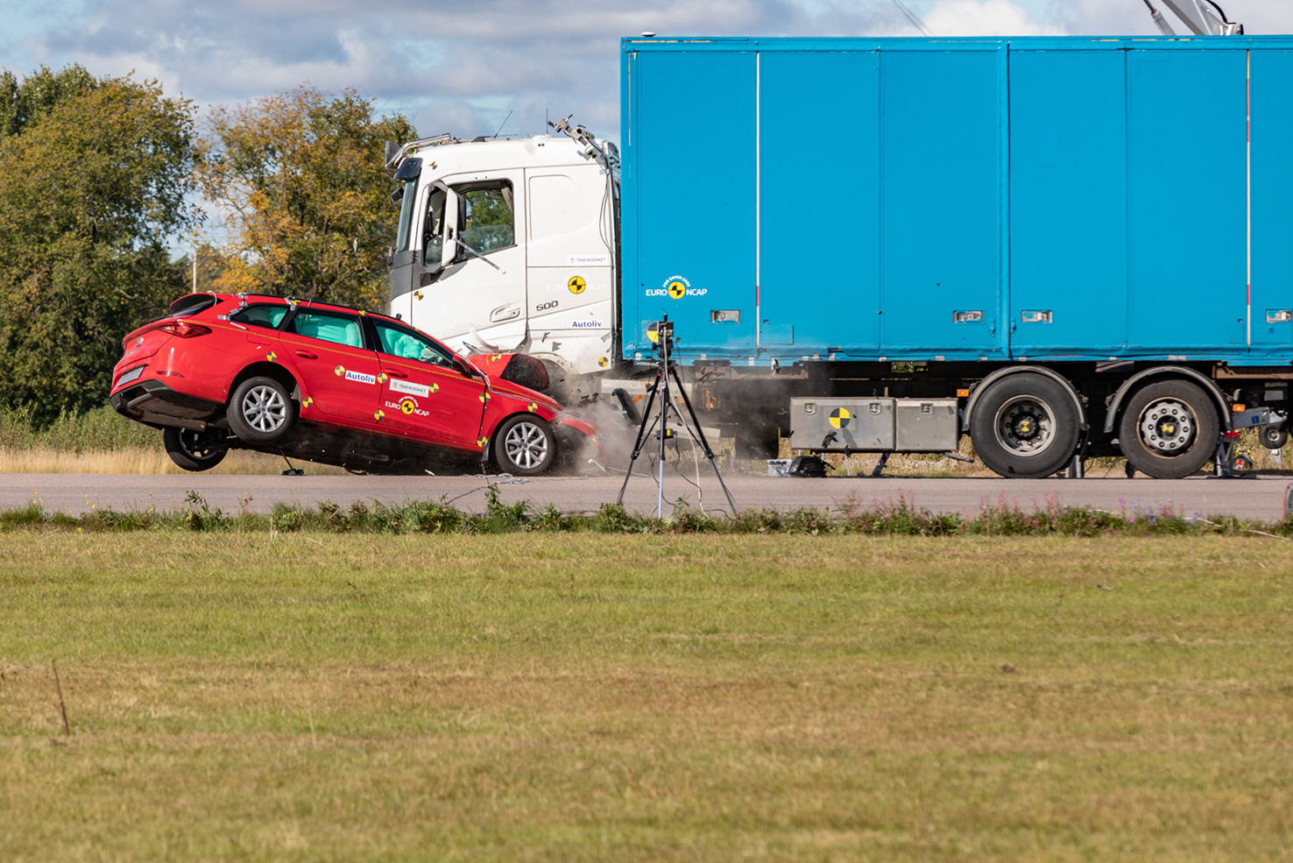
Heavy vehicles
September 2022
50 km/h
Informationsklass
Nivå 2 – Intern

Slide 8
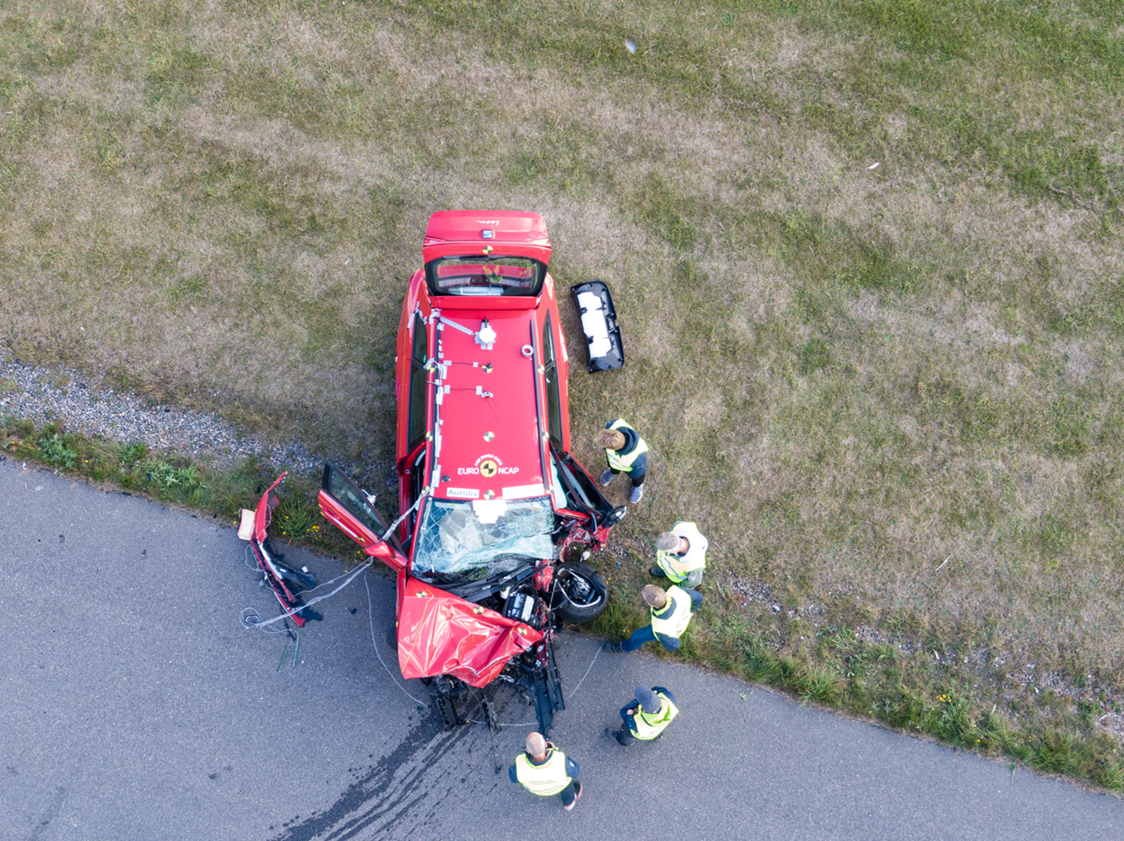
Informationsklass
Nivå 2 – Intern

Slide 9
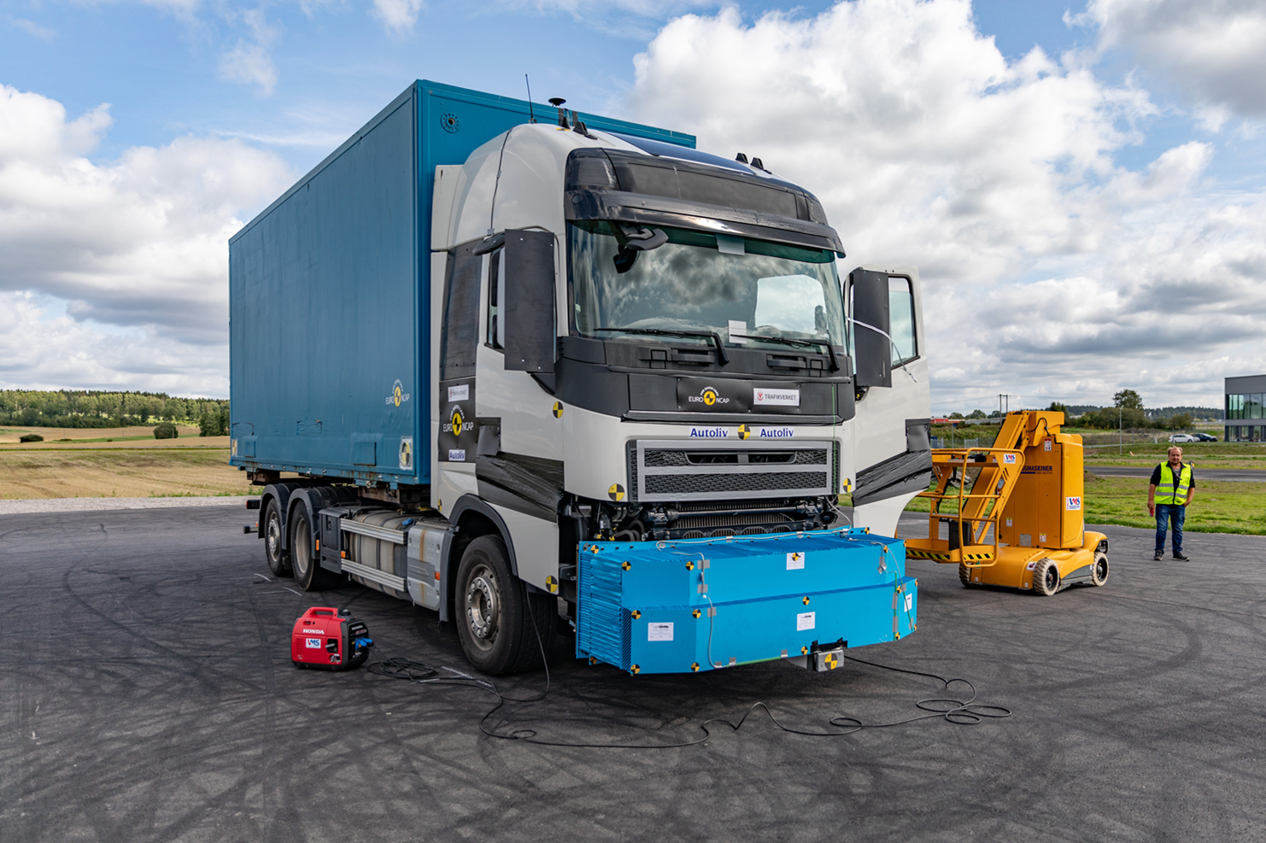
September 2023
Informationsklass
Nivå 2 – Intern

Slide 10
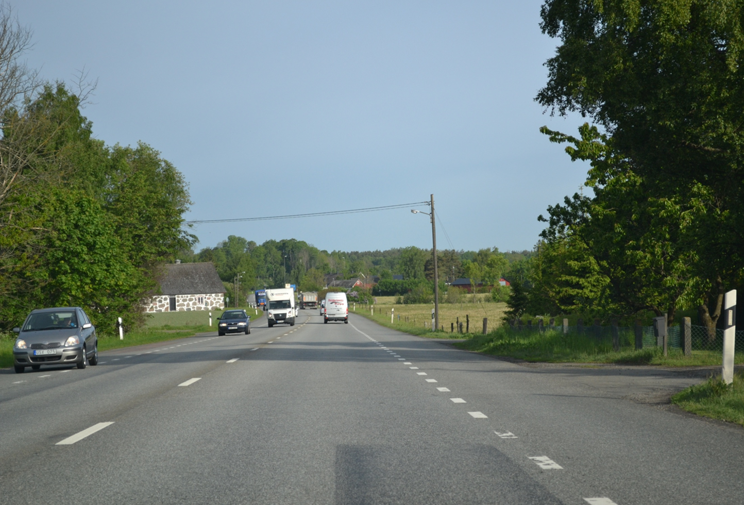
Safe infrastructure?
Too many roads like this
90 or 100 km/h
- unsafe roadsides
Informationsklass
Nivå 2 – Intern

Slide 11
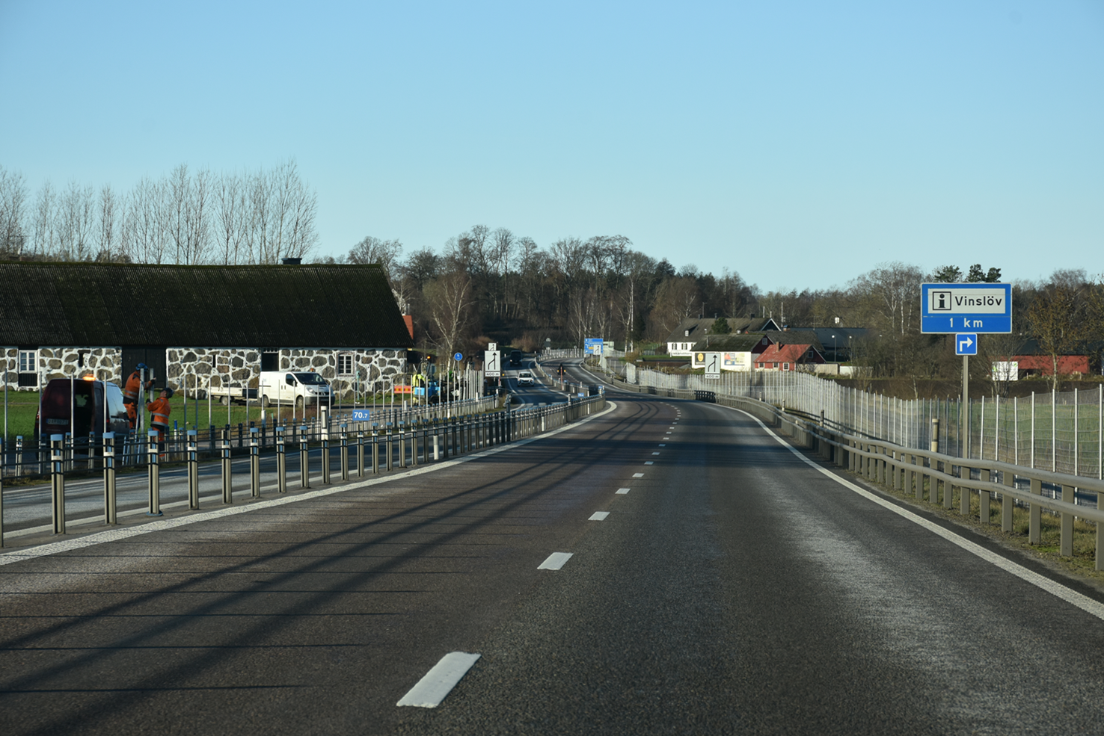
Develop 2+1 road to a more sparse 2+1 road
Informationsklass
Nivå 2 – Intern

Slide 12
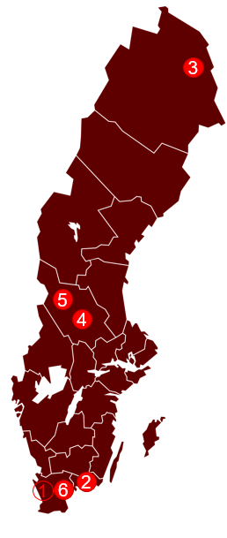
Leadership – sustainable speed
6 pilots with our contractors
Agreement not to speed in contracts
Digital solution show aggregated speeding
Implement within other logistics companies and other organiztions.
Informationsklass
Nivå 2 – Intern

Slide 13
Thank you
Questions?
Stefan.jonsson@trafikverket.se

