Slide 1
Innovative condition data collection methods
What are we currently working on with

Slide 2
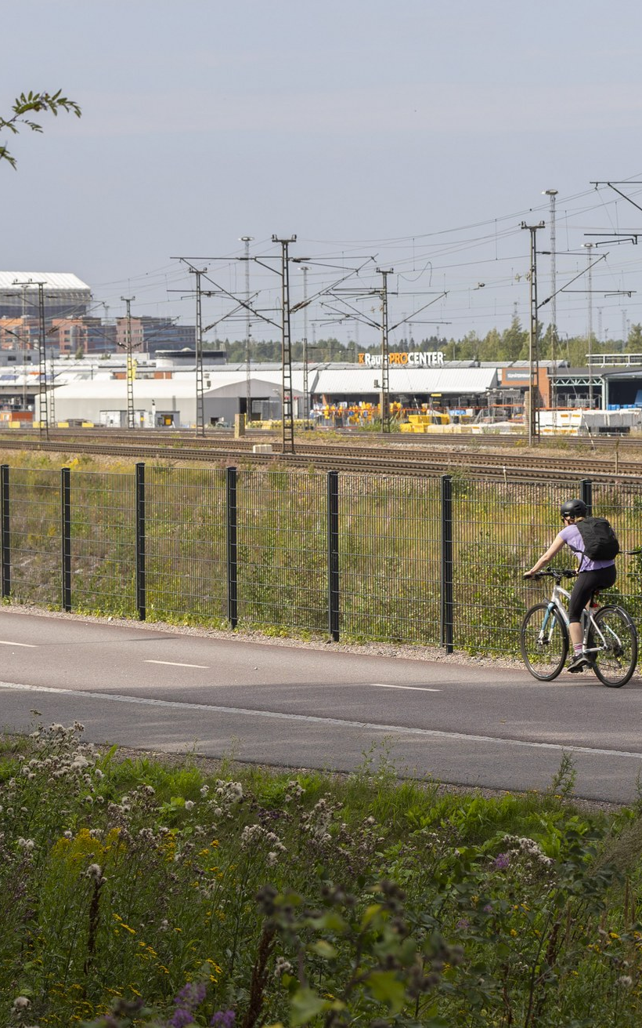
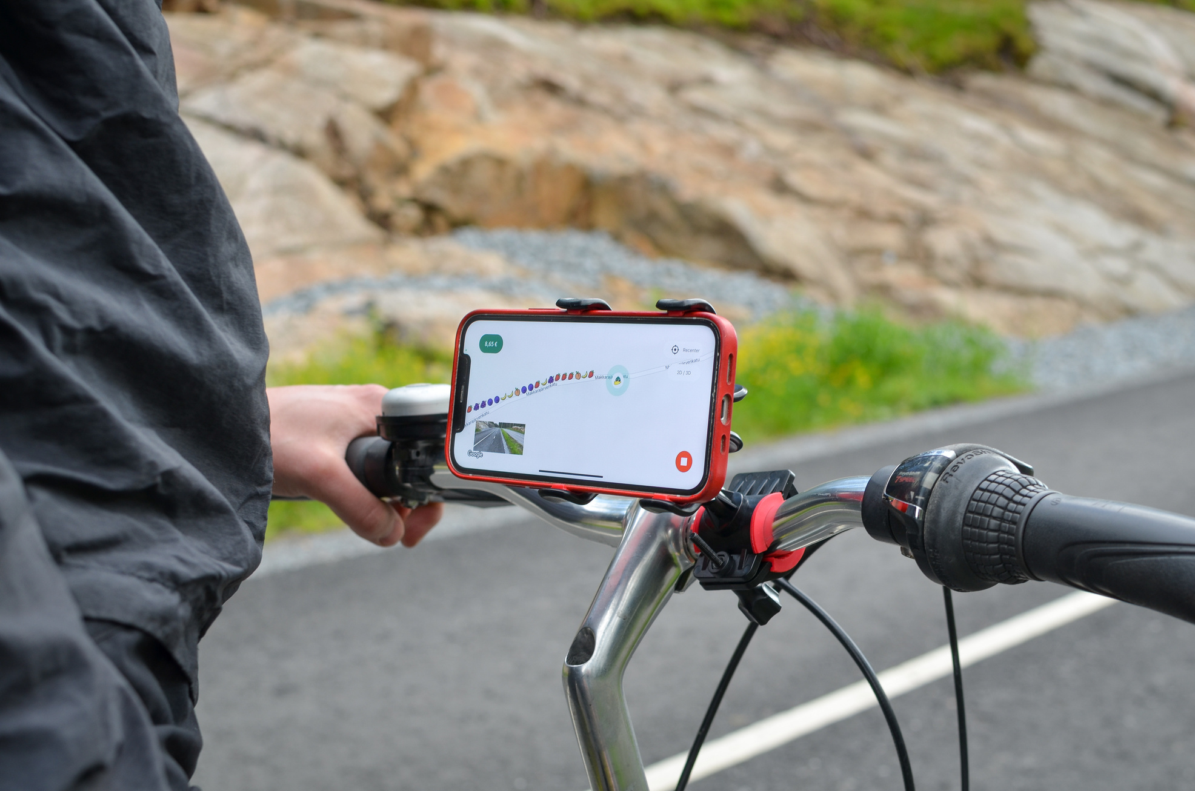
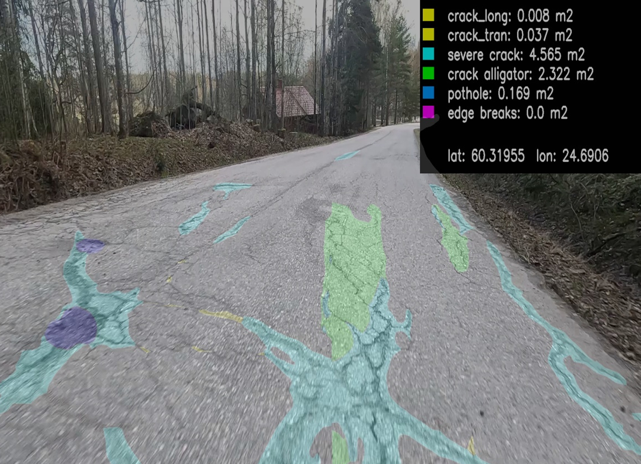
Bicycle paths
Problems: bicycle paths managed like other paved roads, outdated condition data, no condition classification, condition and thus service level differs in different regions
Testing new technologies:
  Crowdsourcing
  Artificial Intelligence
Aims: systematic maintenance planning based on up to date data and estimating future funding needs

Slide 3
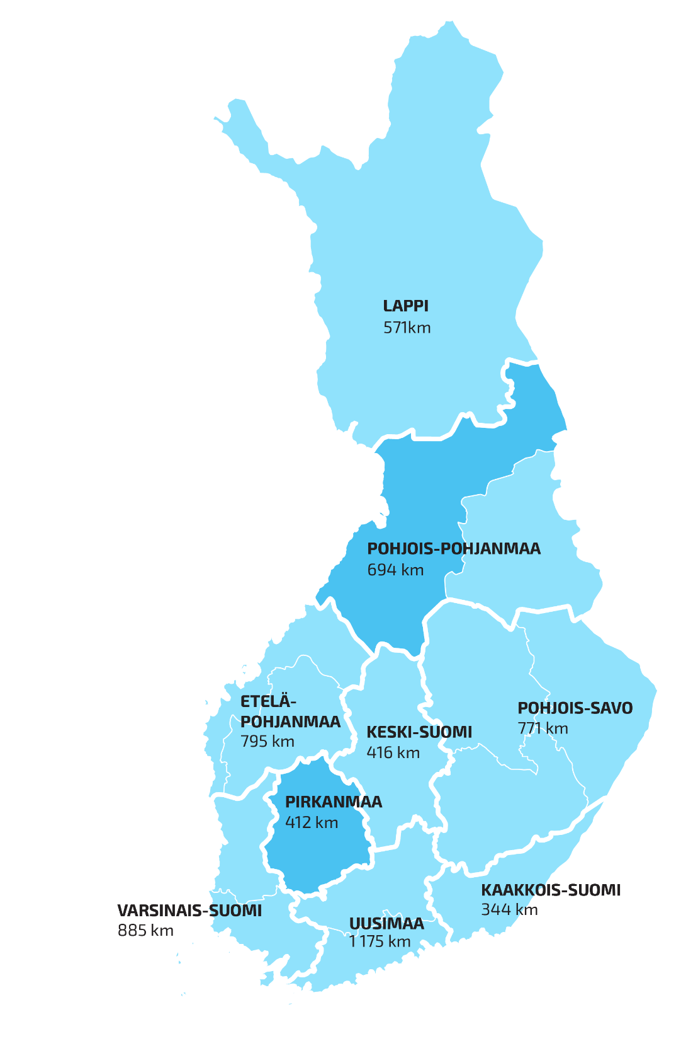
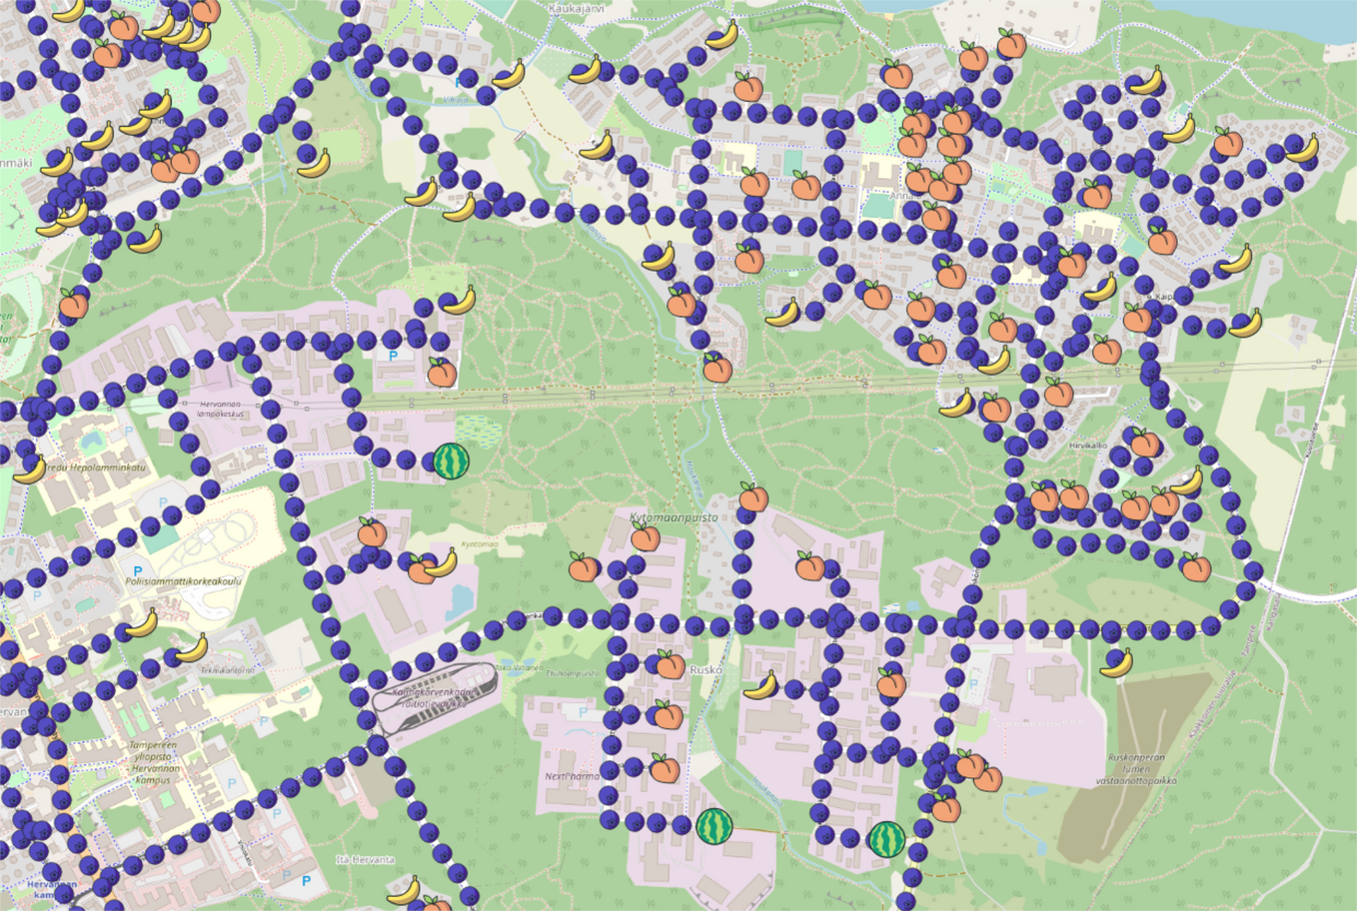
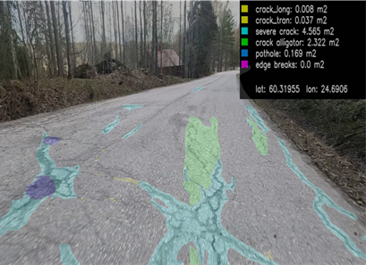
Method
Two regional areas for testing
Crowdsourcing with a mobile game
Videodata collected by cyclists
AI reads the videos to detect pavement defects
Pavement condition classification
User needs identified
Asset Management Plan program to create maintenance program

Slide 4
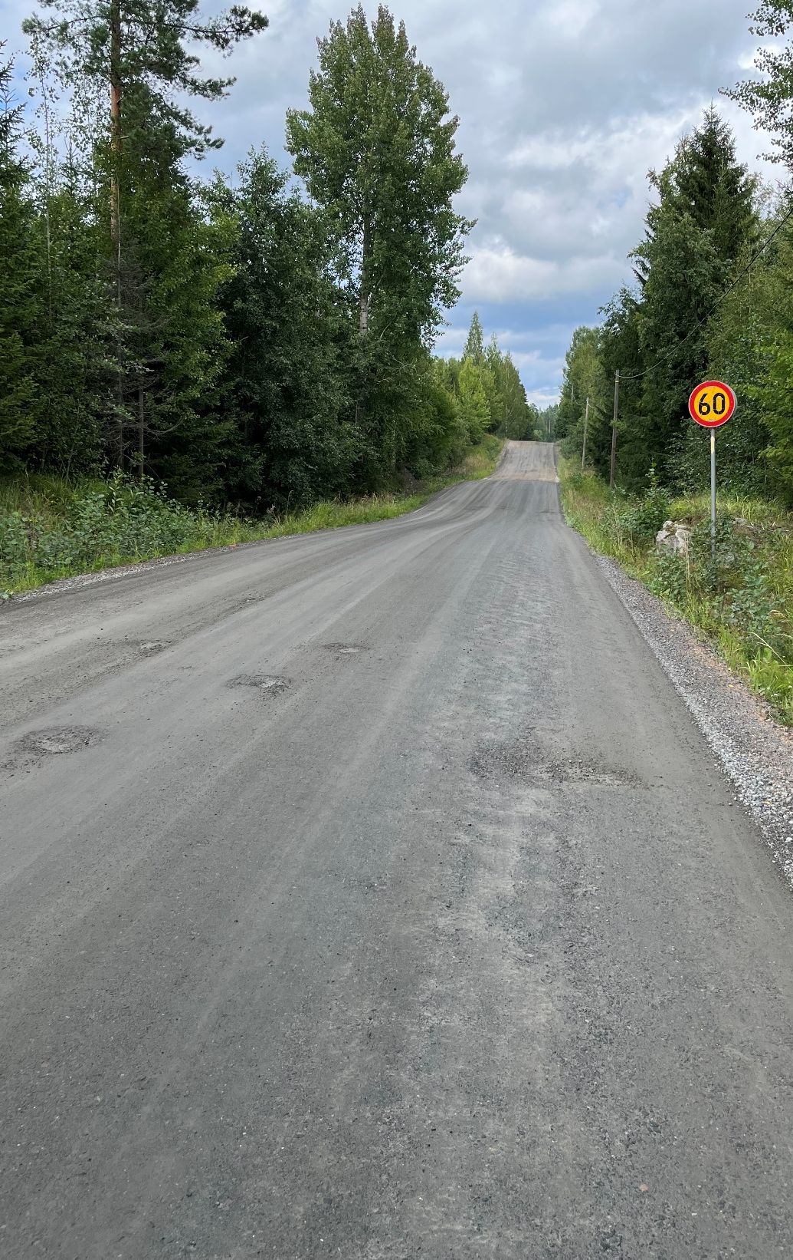
Gravel roads
Research project: “Condition management on gravel roads based on measurements”
Evenness (surface roughness), dustiness, surface firmness, frost heaving on surface
Measuring methods:
  3D accelerometer
  Laser scanner
  Photos
26 000 km of gravel roads
Low traffic, but important for forestry, industry, agriculture, people
Need of up to date data for maintaining service level

Slide 5
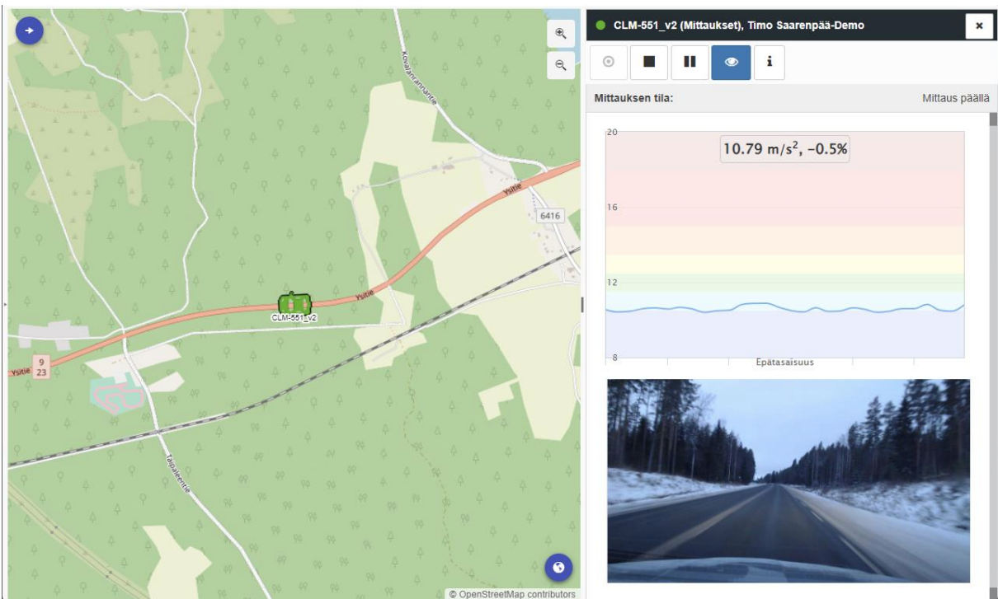
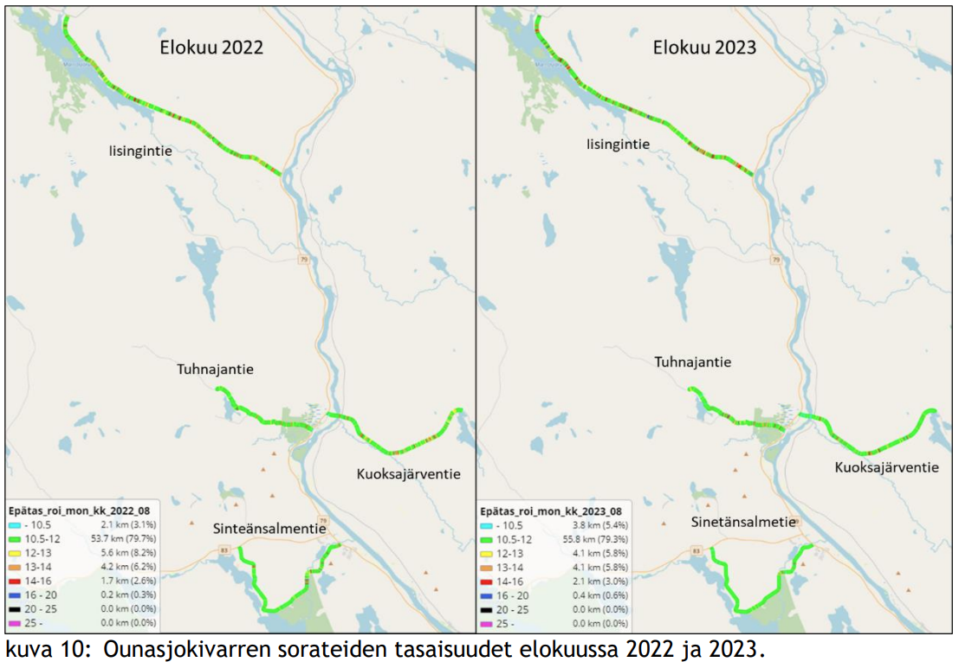
Surface condition data
Condition changes can be rapid and sudden
Maintenance project managers’ cars equipped with measuring equipment
  Collecting the data while driving the routes in their maintenance responsibility areas
Vertical acceleration converted to condition data
Finding potholes, rutting, washboarding (corrugation)
How do the results compare to human eye?
How does the measuring car itself and it’s speed affect the results?

